Slide 1
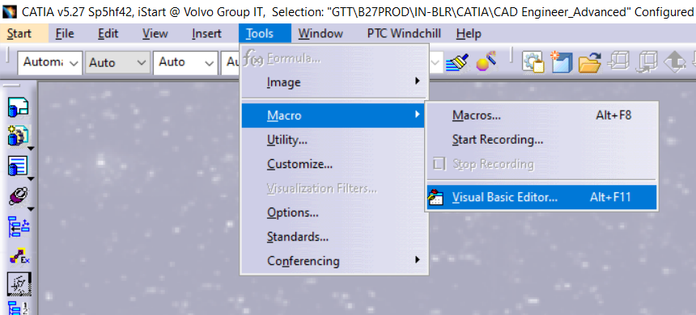
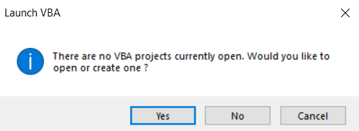

Slide 2
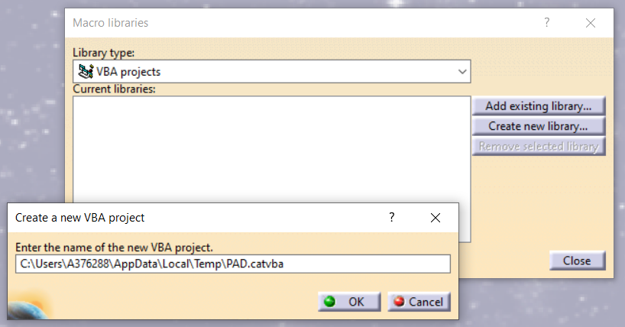
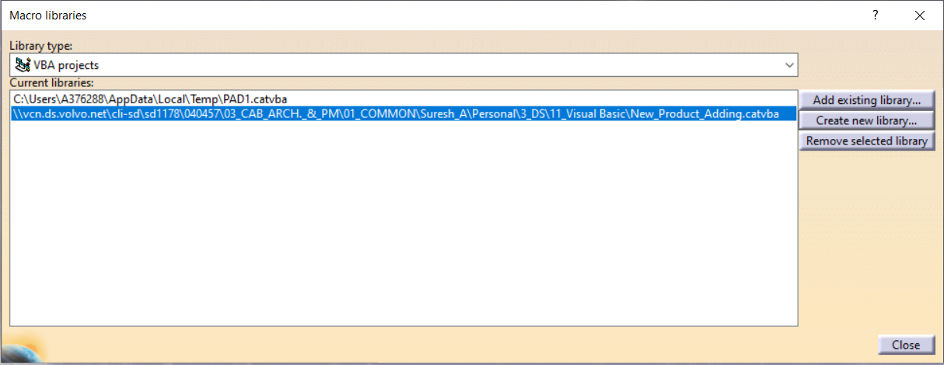

Slide 3
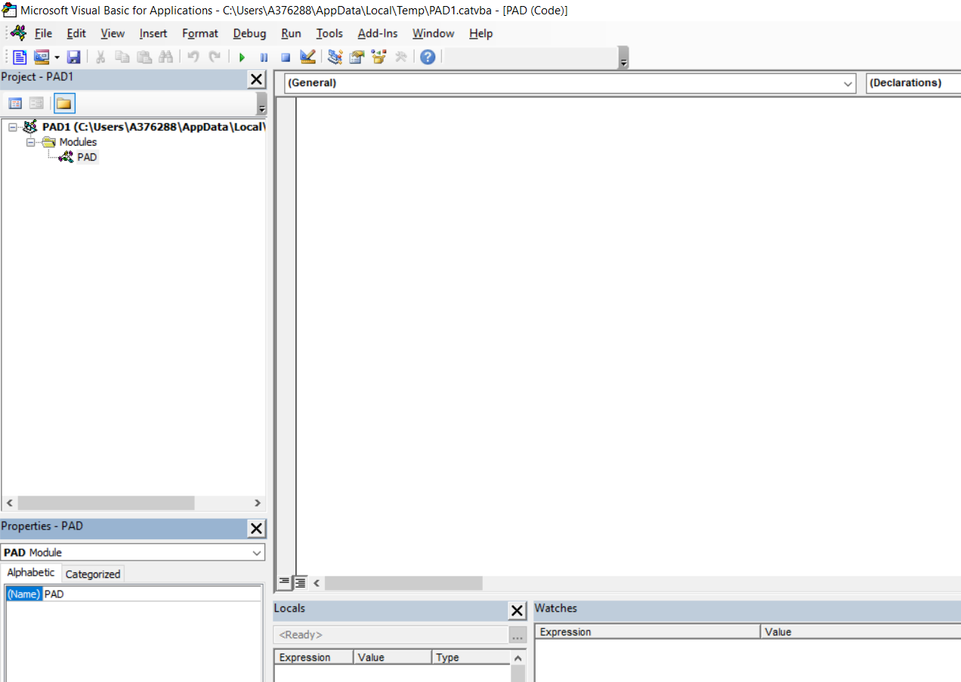

Slide 4
New Products Adding

Slide 5
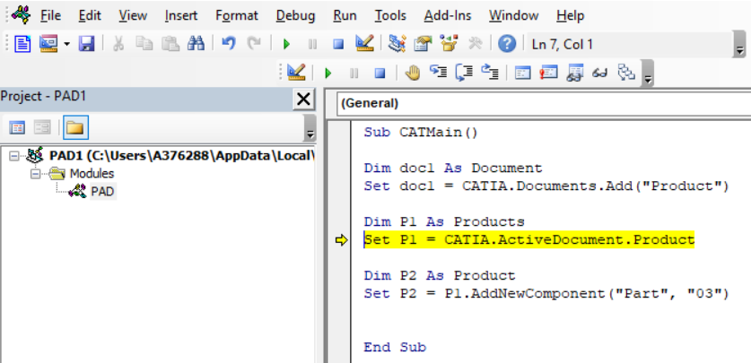
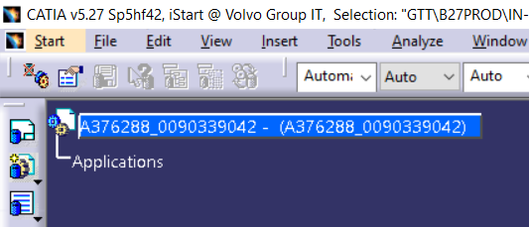
Sub CATMain()
Dim doc1 As Document
Set doc1 = CATIA.Documents.Add("Product")
Dim P1 As Products
Set P1 = CATIA.ActiveDocument.Product
Dim P2 As Product
Set P2 = P1.AddNewComponent("Part", "03")
End Sub

Slide 6
